Slide 1
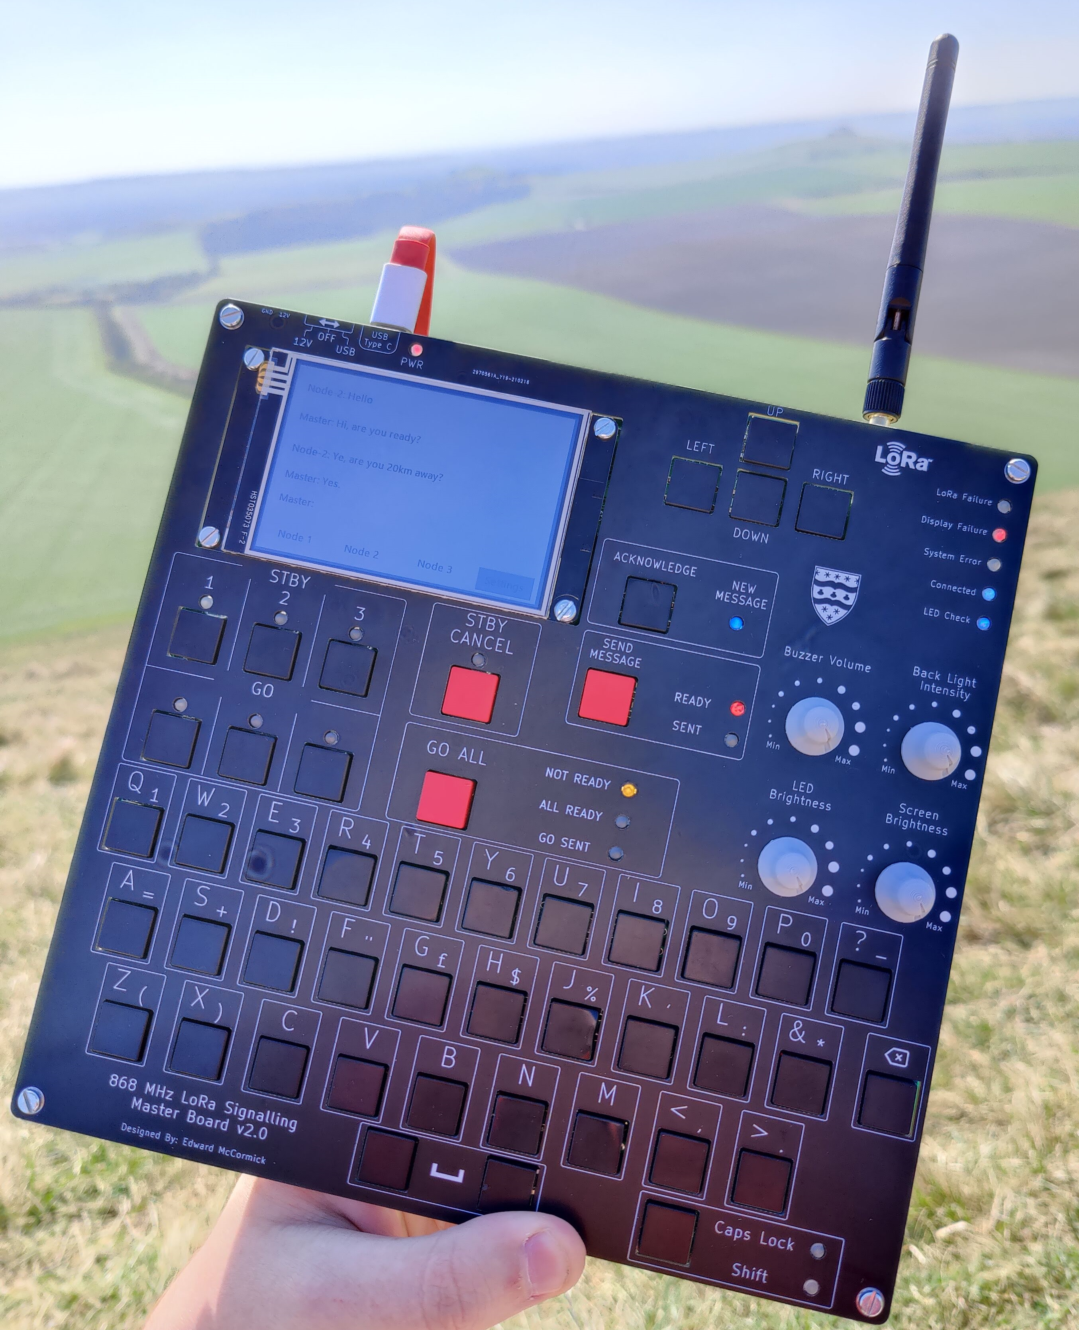
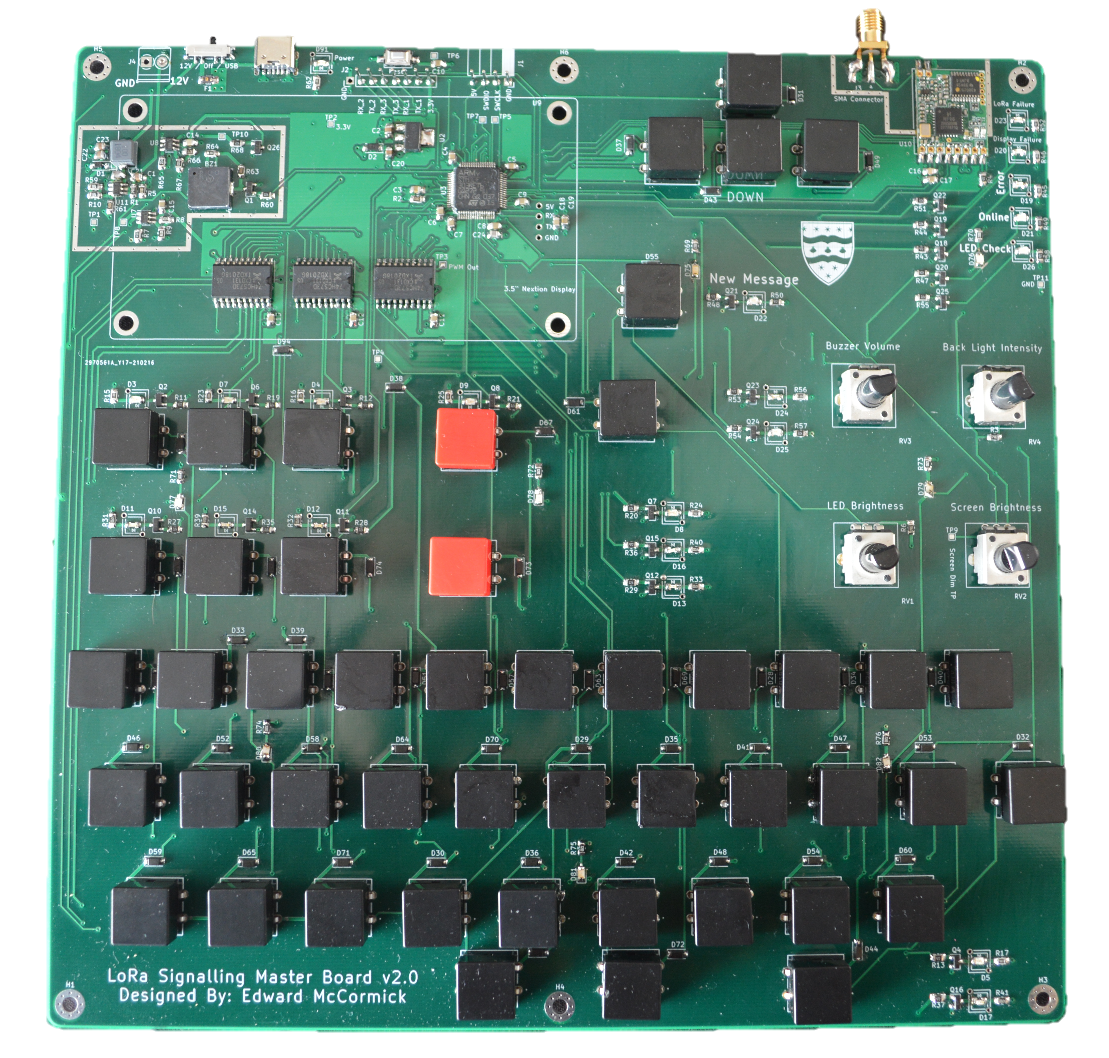
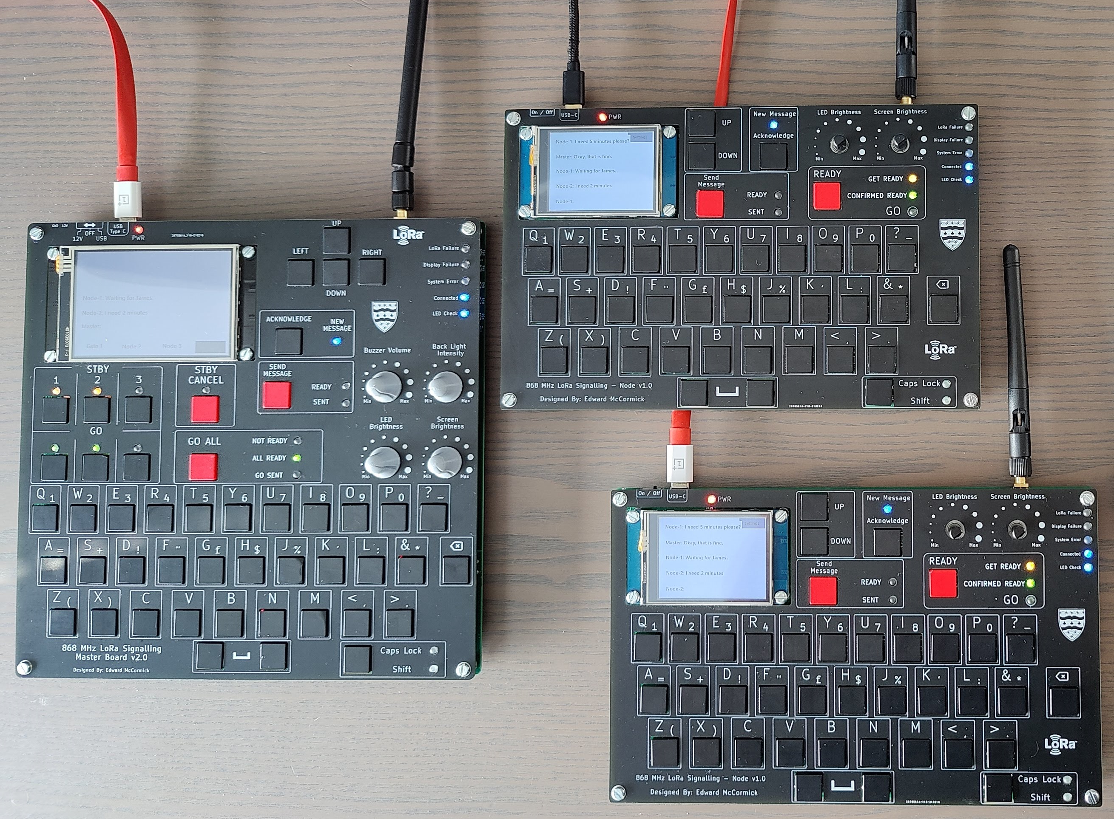
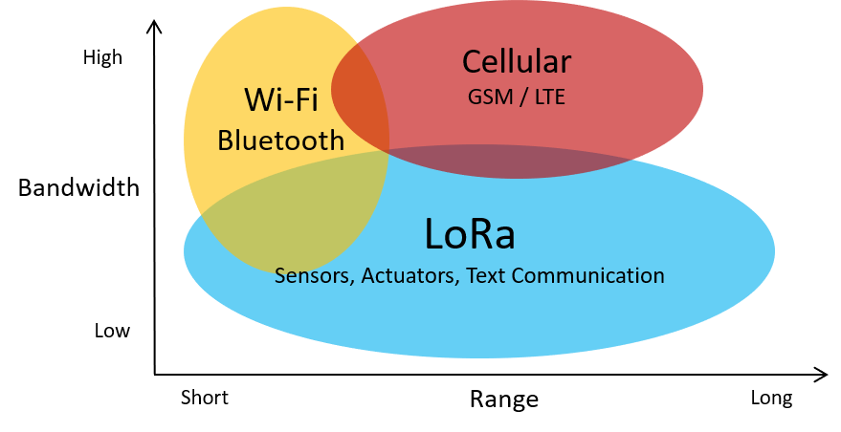

LoRa® Based Signalling and Communication System for Events
May 2021
Overview:
In the events industry communication and timing are critical to success. A range of techniques are currently used to provide this communication however they are either too expensive or offer limited functionality.
My product aims to address both these issues by using new LoRa technology from Semtech. The system will offer the ability for one person to lead multiple teams at ranges in excess of 20km.
Summary:
Long Range (>20km)
Inexpensive
1 Master Controller
3 Nodes/Outstations
Text Communication
Event Signalling Features
Surface Mount STM32
868MHz Operating Frequency
Low Power
USB or 12V Powered
What is LoRa?
LoRa (short for long range) is a chirp spread spectrum modulation technique owned by Semtech. With the ability to work below the noise floor where most signals would be lost, LoRa offers exceptional range (>20 km) at very low output power.
Edward
McCormick
MEng Electrical & Electronic Engineering
edward.mccormick@students.plymouth.ac.uk

Slide 2
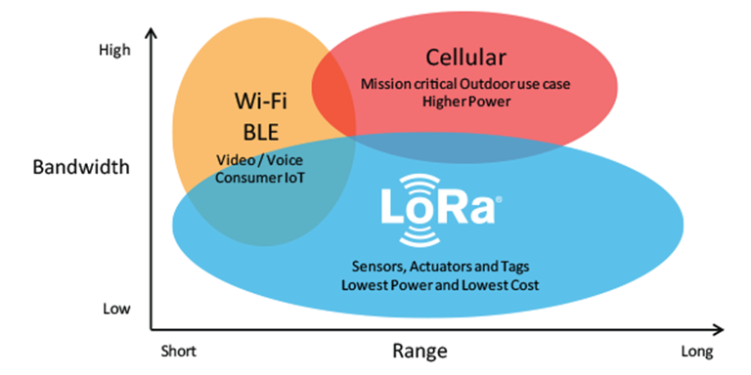
High
Cellular
GSM / LTE
Wi-Fi
Bluetooth
Bandwidth
LoRa
Sensors, Actuators, Text Communication
Low
Short
Range
Long

